Slide 1
The Mississippi State University erle: Exploration, research and learning environment a transformative PROJECT to promote student success, facilitate economic development, and advance msu
Spring 2023

Slide 2
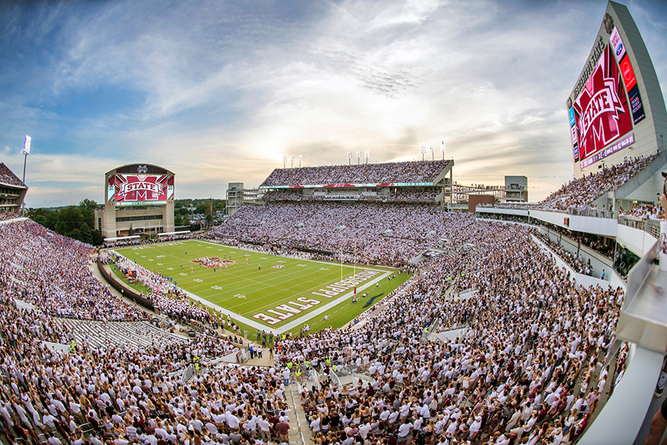

Mississippi State University: A Comprehensive Land-Grant Institution
Athletics is often viewed as the ‘front porch’ of the university

Slide 3
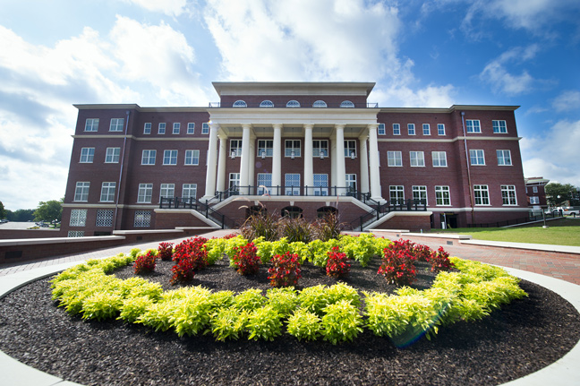
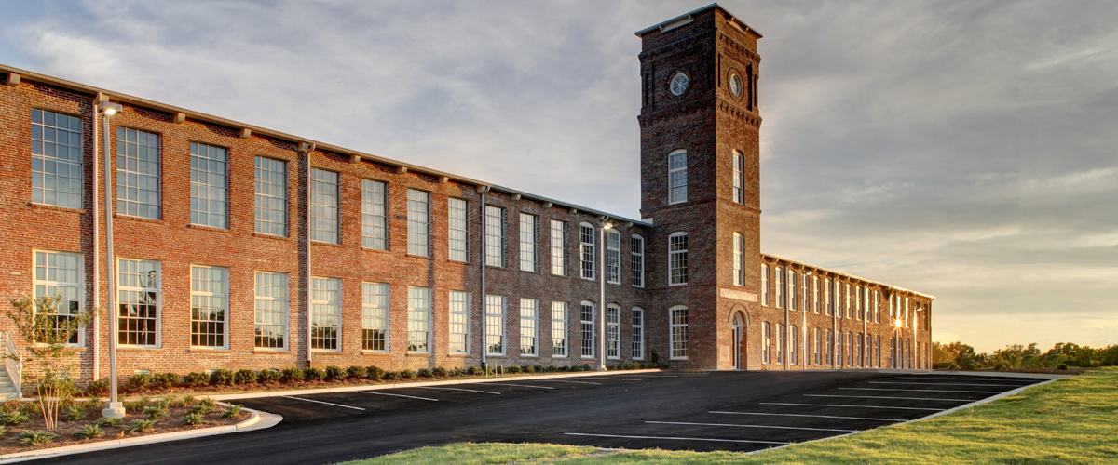
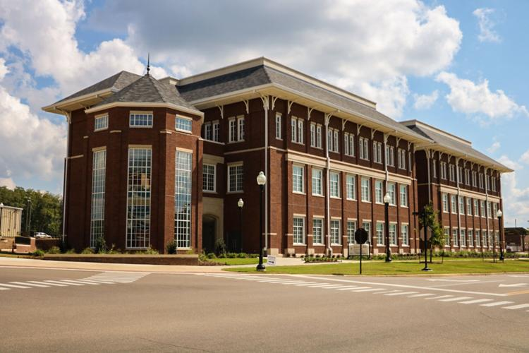
Mississippi State University: A Comprehensive Land-Grant Institution
and while the library supports academics and research that serve as the ‘classroom’ and ‘laboratory’

Slide 4
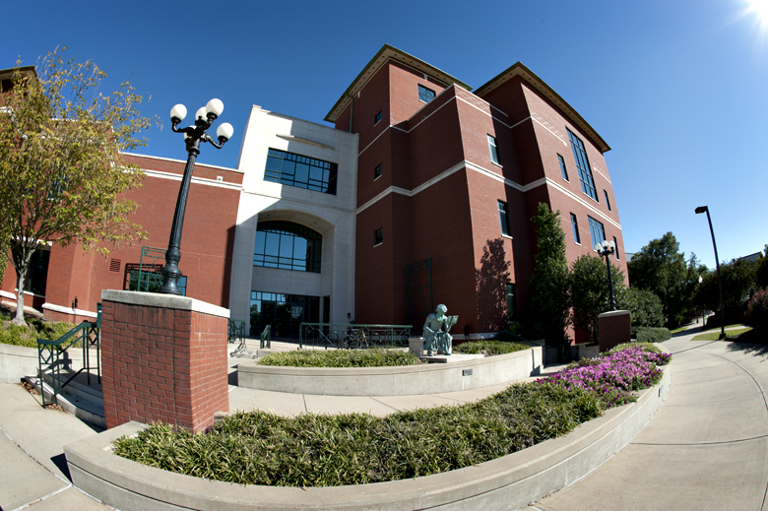
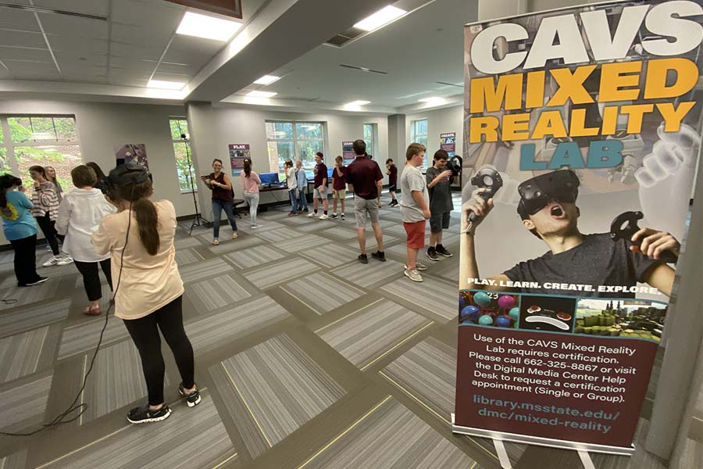
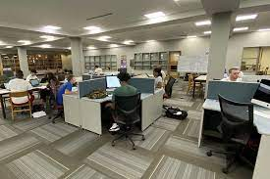
Mississippi State University: A Comprehensive Land-Grant Institution
the centrally located Mitchell Memorial Library can also be the ‘living room,’ showcasing the university to students, faculty and the community for study, social networking, research, prototyping, and interdisciplinary collaboration

Slide 5
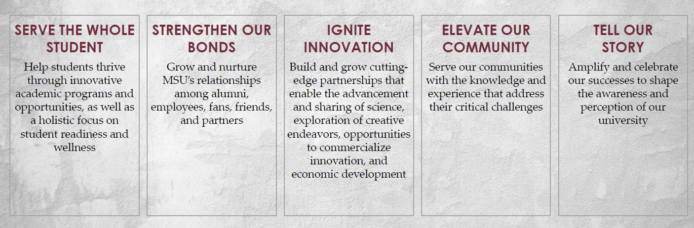
Mississippi State University: A Comprehensive Land-Grant Institution
and impact the MSU Strategic Plan for Transformational Change while Taking Care of What Matters

Slide 6
Alignment with the MSU Transformational Plan
Support student & faculty success by transforming Mitchell Memorial Library to a central learning and social hub for the institution:
  Establish an Archival Research Center to enhance preservation efforts and free up over 70,000 square feet
  Create unique spaces for various uses including cross-disciplinary design projects, integration with industry, student & faculty socialization / collaboration, and independent/group study
  Health and wellness activities
  Answers a key question: where do we enact key components of the MSU Transformational Change Plan?

Slide 7
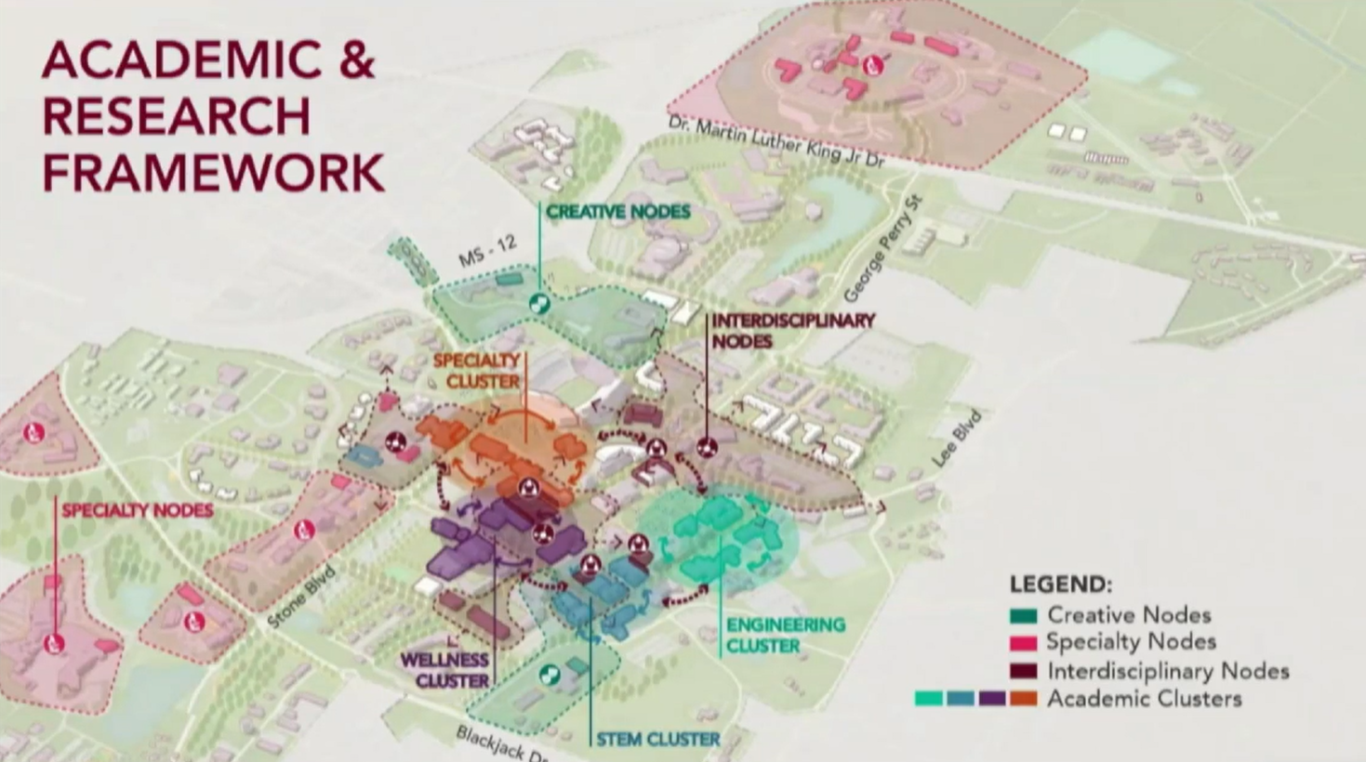
Sasaki Presentation to
MSU Faculty Senate, Nov.’21
“Colvard Union is overwhelmed by the number of students...”

Slide 8
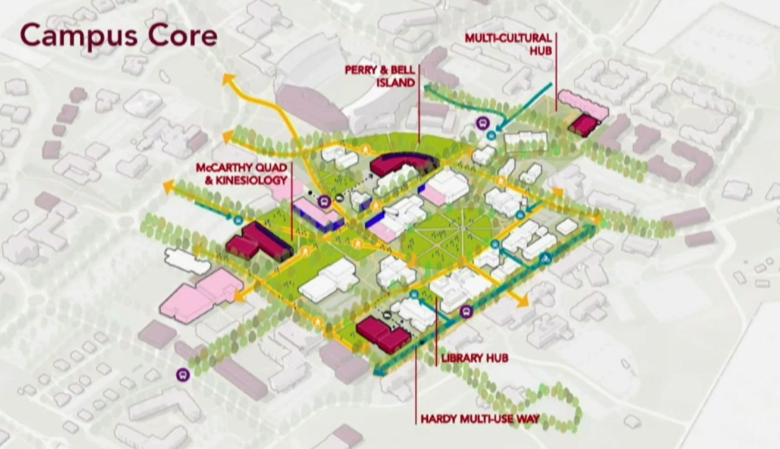
Sasaki Presentation to
MSU Faculty Senate, Nov.’21
“Library Hub…a rethink of that building to make it more about student engagement and collaboration…”

Slide 9
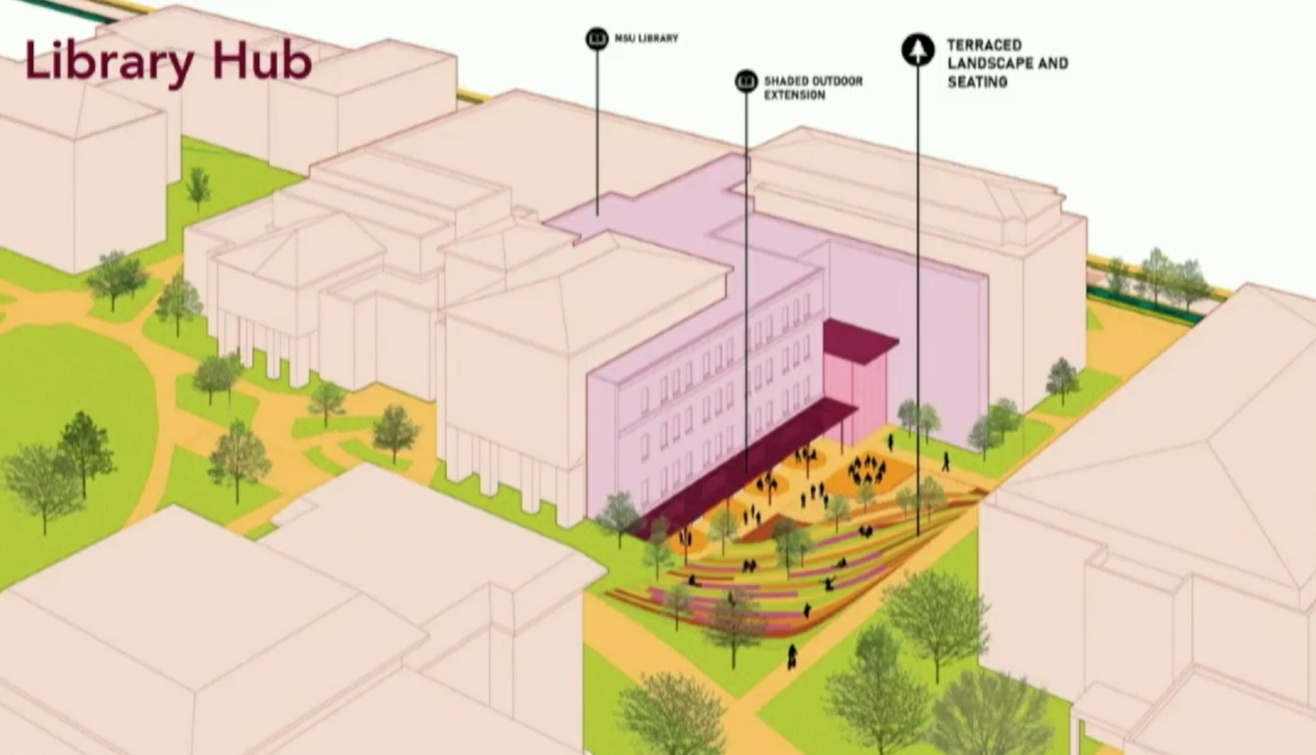
Sasaki Presentation to
MSU Faculty Senate, Nov.’21
“is there an opportunity to
create a study garden /
study environment”
“part of a future master plan for the library”
“a key opportunity”

Slide 10
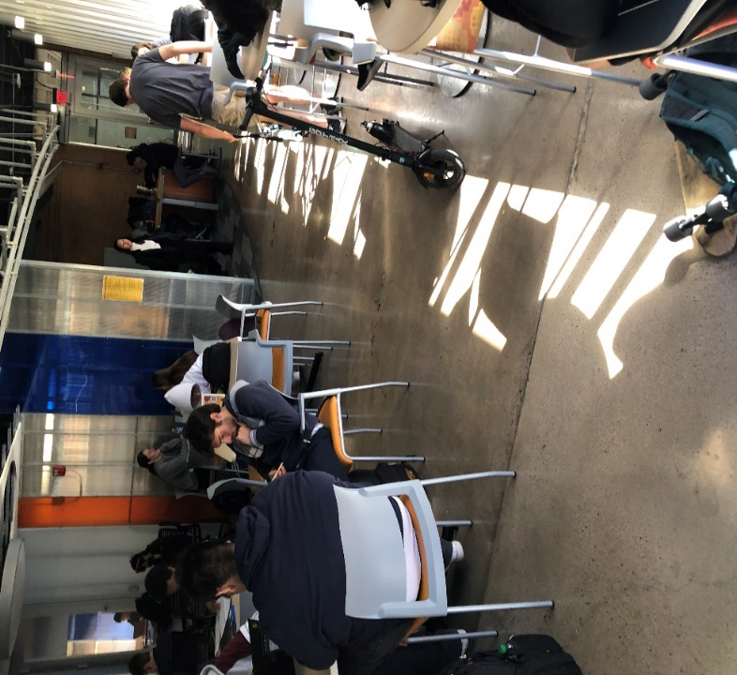
New Millennium Learning, Social &
Research Spaces
Arizona State University
  Flexible Learning Environment
  Tutoring and Student Centers
University of Guelph
  Multipurpose Common Spaces
  Interdisciplinary Collaboration & Creation Spaces

Slide 11
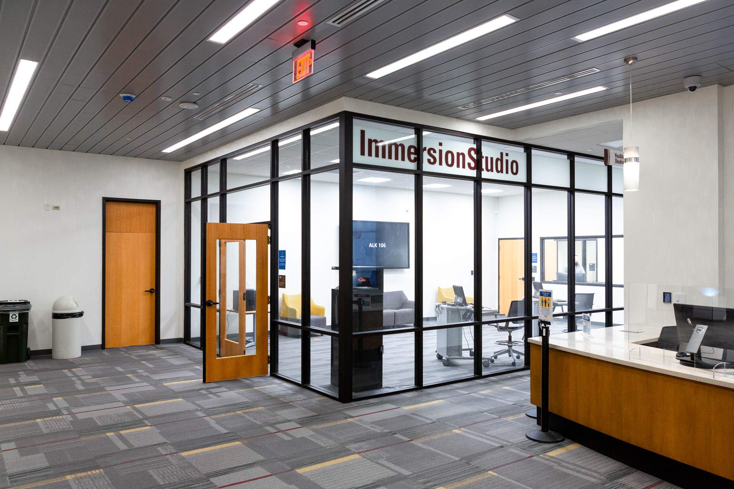
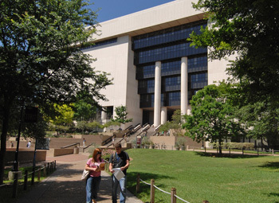
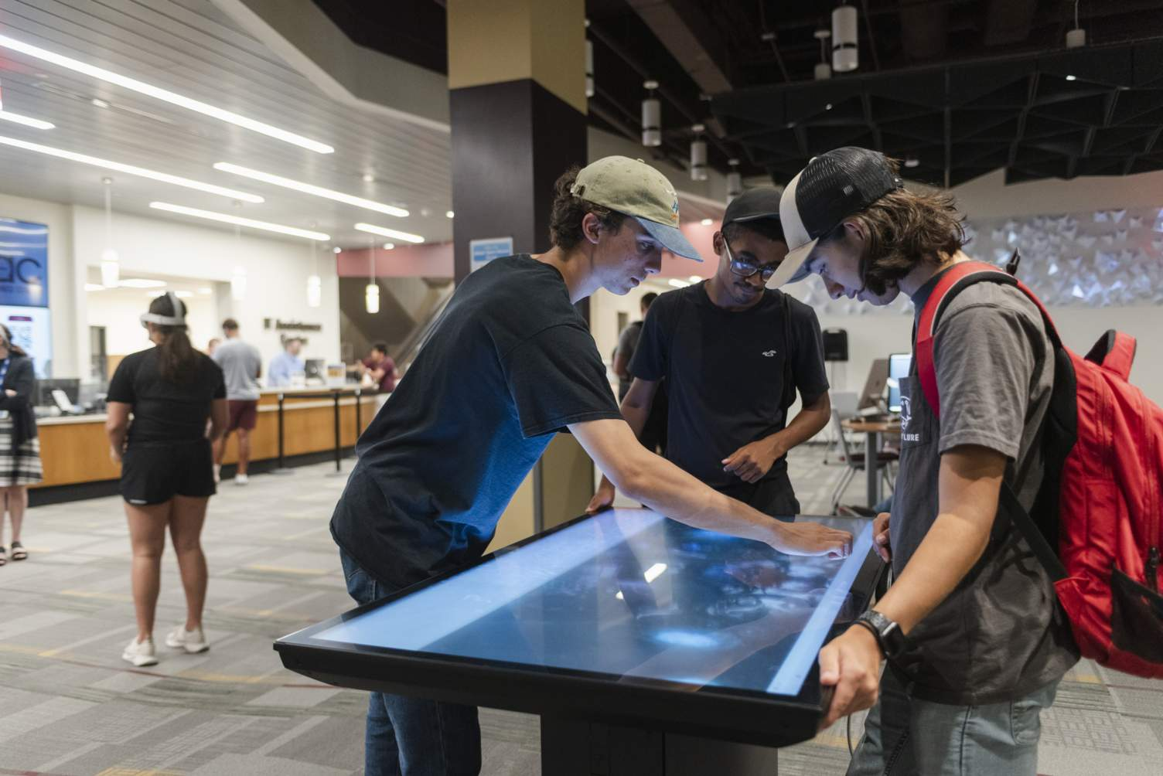
Texas State University
Multi-Phased Transformation of an R2 institution: New Technology and Spaces
Library as Interdisciplinary
Research Idea Hub

Slide 12
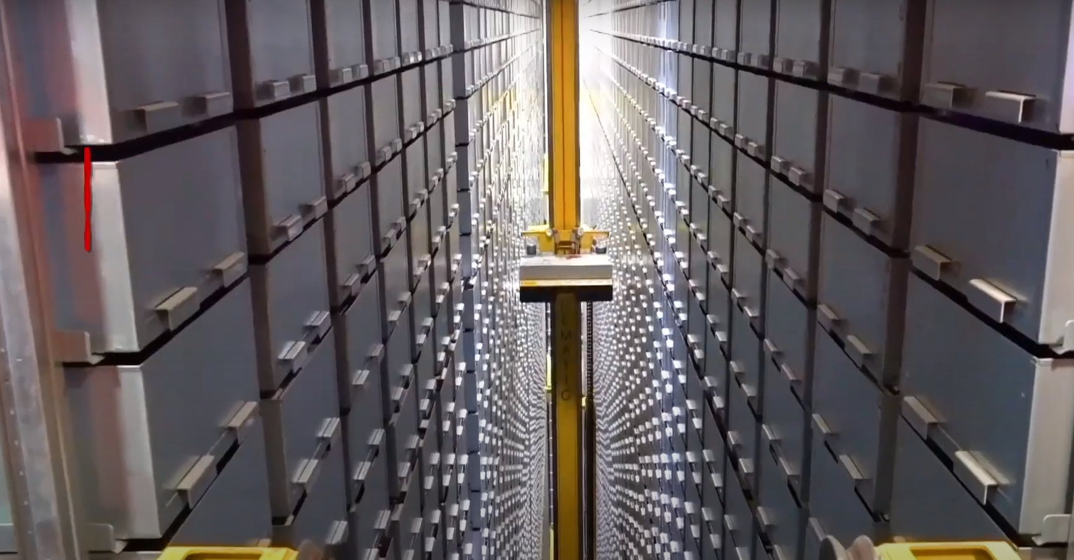
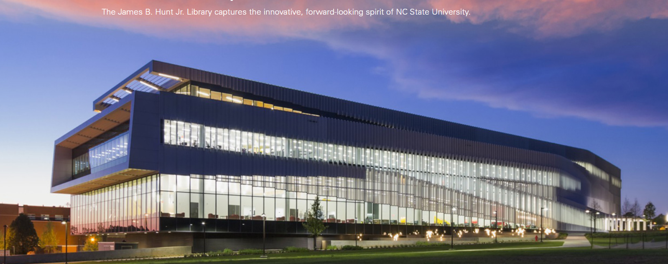
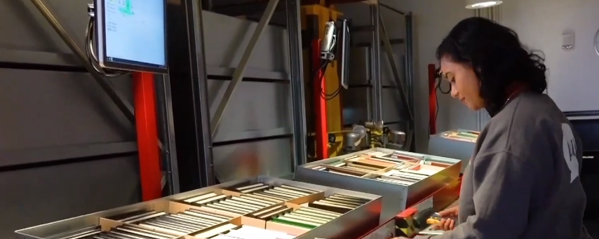
What is an Archival Research Center?
1.1MM books via automated storage / retrieval, NCSU
https://www.youtube.com/watch?v=AIKo6bqR_eA

Slide 13
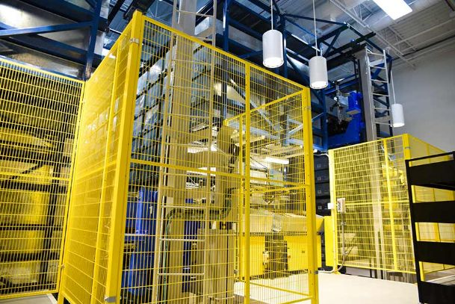
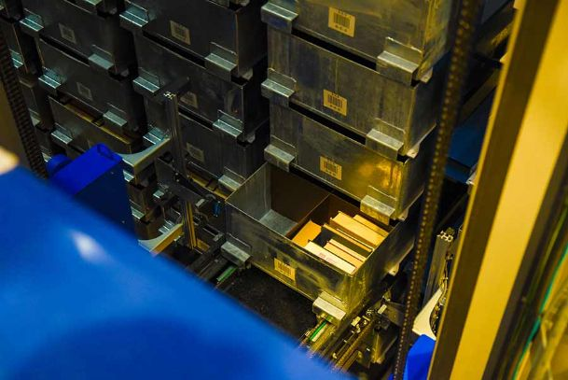
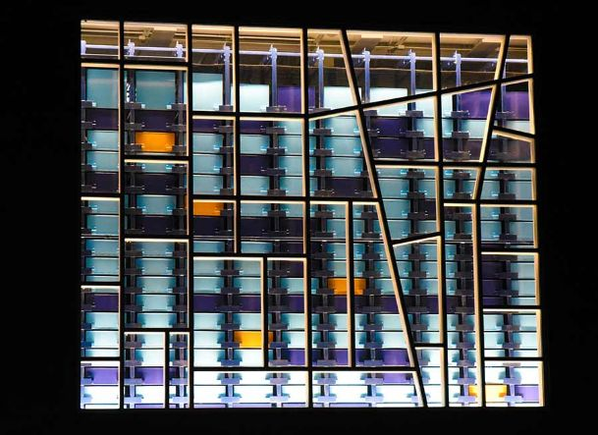
What is an Archival Research Center?
Fant Library, MUW

Slide 14
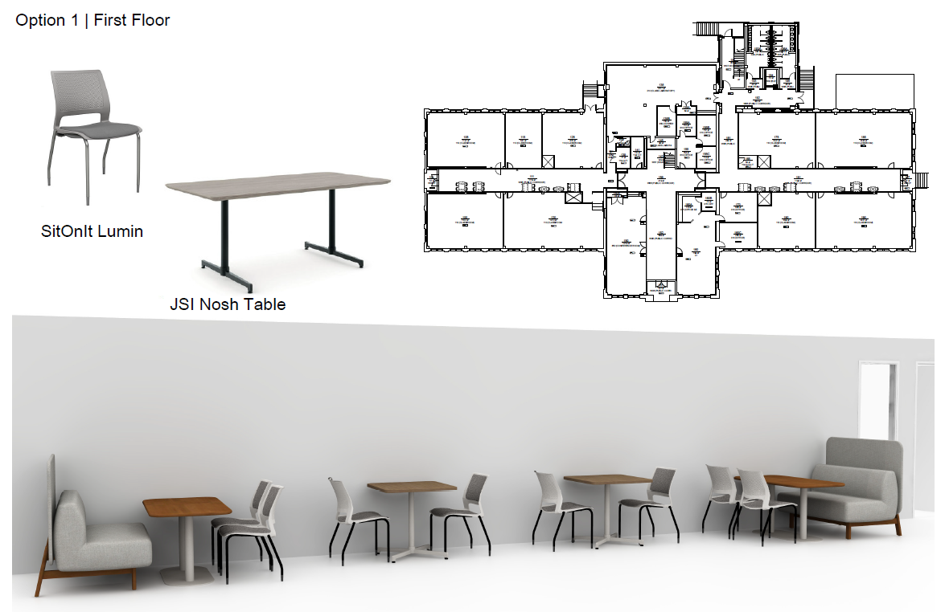
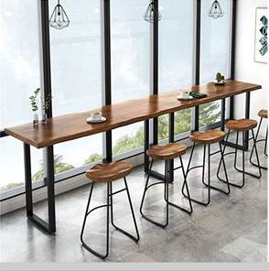
Current Space Plans & Dreams: BCoE
McCain Collaborative Hallway
Seating (planned for 2023)
Industrial Engineering Student
Seating (planned for 2023)

Slide 15
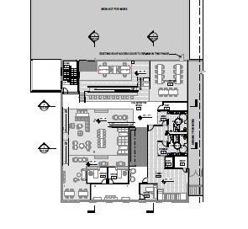
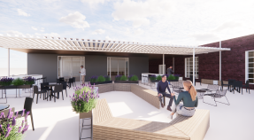
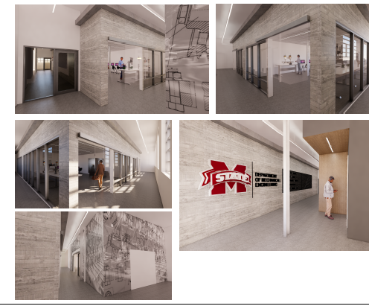
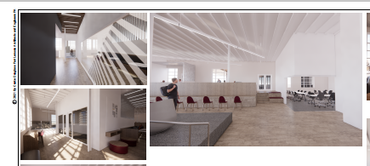
Current Space Plans & Dreams: BCoE
Patterson ME iDEELab Renovation
(fundraising underway)

Slide 16
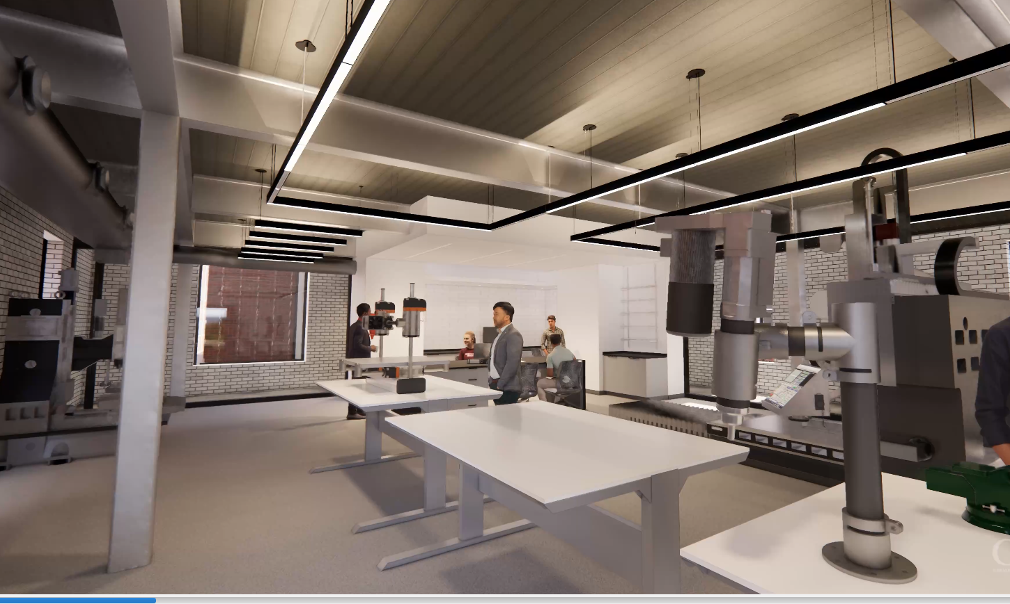
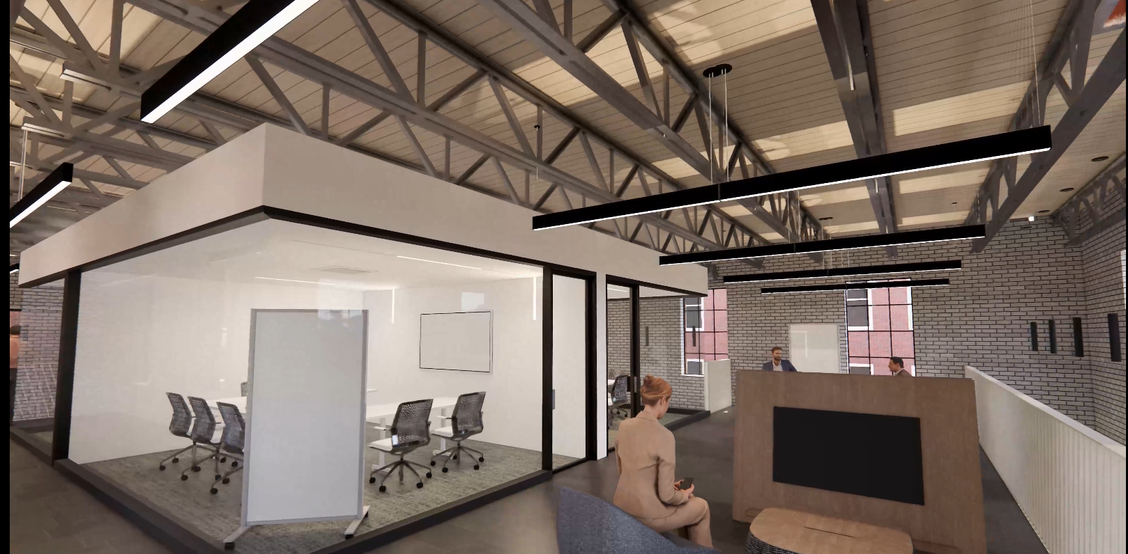
Current Space Plans & Dreams: BCoE
Randy J. Cleveland
Engineering Student
Center (underway)

Slide 17
Current Space Plans & Dreams: CAAD
Plans are underway to transform the CAAD Library into a unique space that better serves the needs of its interdisciplinary college.
The space will be collaborative, adaptable & technology enabled.
The CAAD Library will serve as a 3rd space/place for students & faculty on an ever growing and busy campus

Slide 18
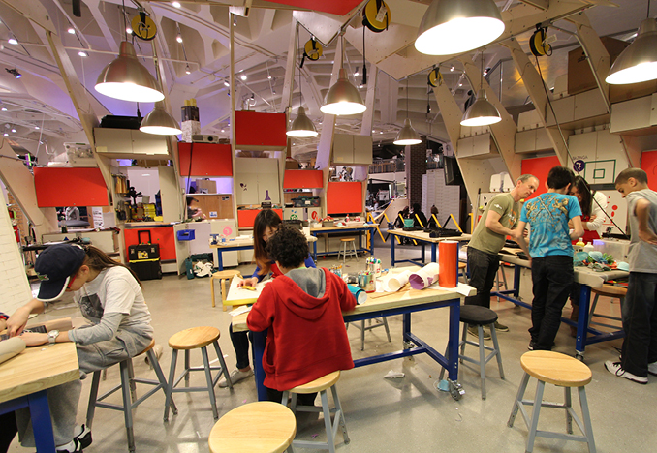
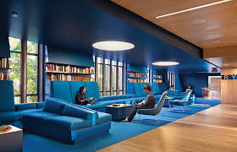
Collaborative Makerspaces: Student & Faculty Project
and Innovation/Industry/Incubator Spaces
Imagineering Design

Slide 19
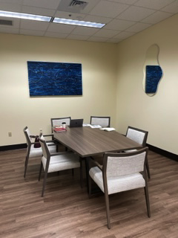
Current Space Plans & Dreams:
Dean’s Suite & CMS
Mobile, wireless connectivity
Donor engagement & fundraising
Hoteling model for office spaces
Reconfigurable
Emphasizing team projects &
community building

Slide 20
Current Space Plans & Dreams:
Mitchell Memorial Library
Enable and Transform over 70,000 square feet of library space towards student learning and success as well as new faculty R1 research possibilities
** New construction cost ~ $600 / sq ft
** Renovation cost ~ $ 200 / sq ft

Slide 21
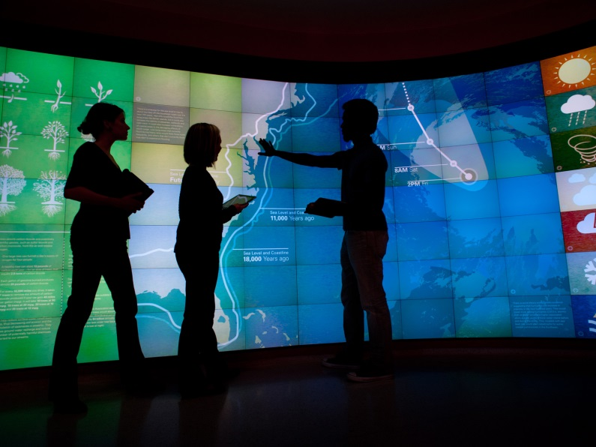
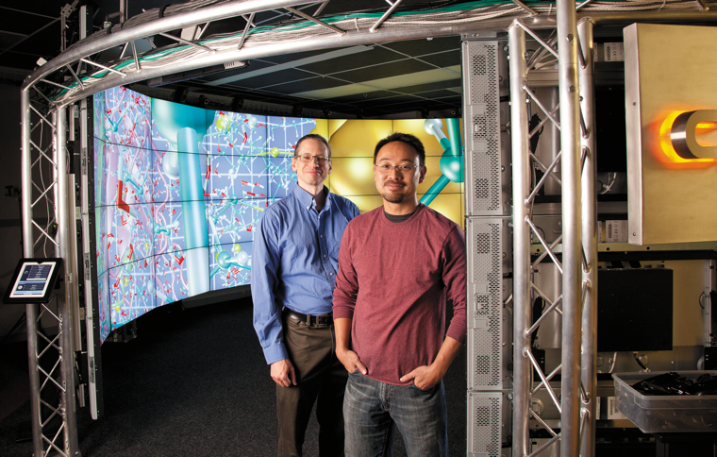
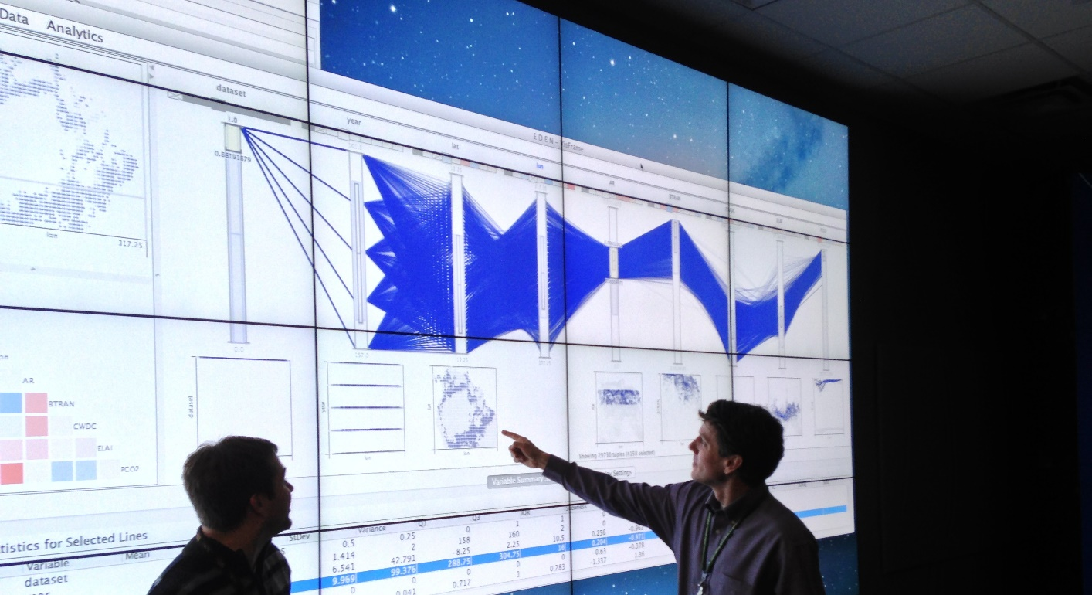
Immersive Technologies
Visualization Walls
Mixed Media Reality
Research Data Visualization

Slide 22
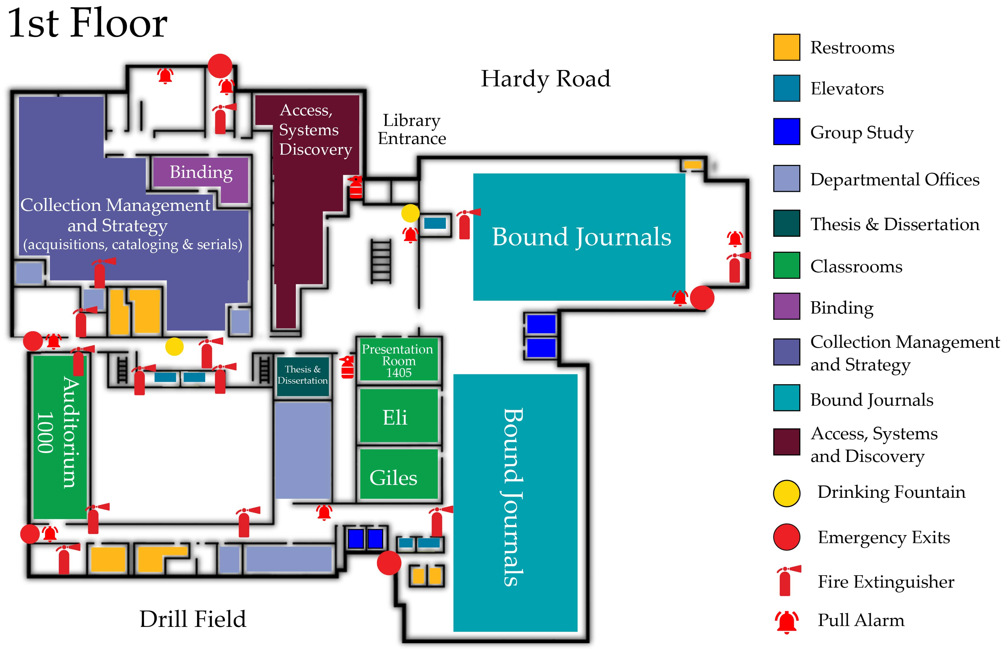
Current 1st Floor
Bound Journals:
Filled: 270,000
Capacity: 306,000

Slide 23
Digitization
Print Collection
Proposed 1st Floor
Move Bound Journals
Off-site
Relocate Circulating
Collection (A-Z)
into compact shelving
Print Collection
Faculty / Graduate Lounge / Reading Room

Slide 24
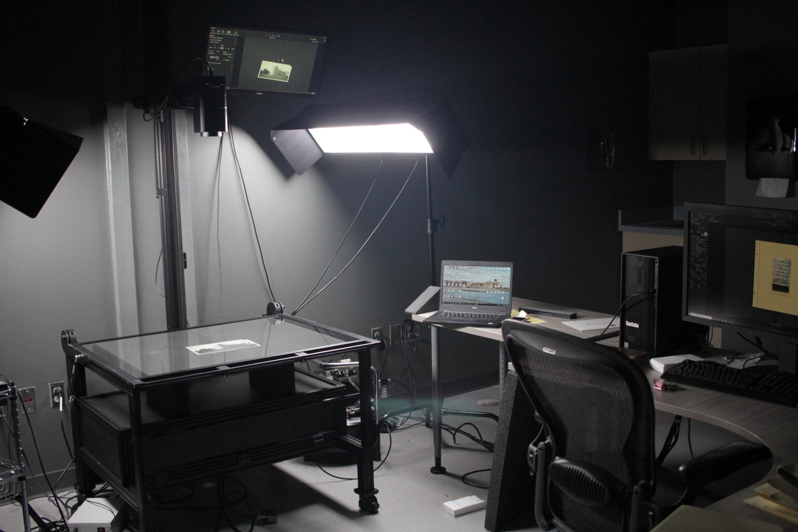

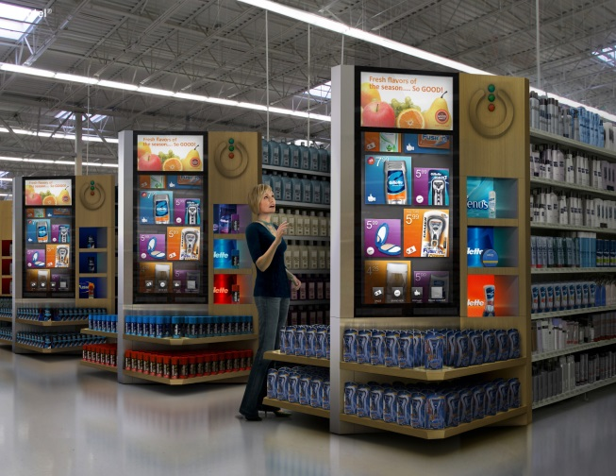
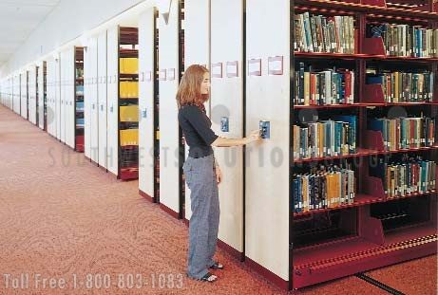
Digitization Lab
Faculty Lounge
Compact Shelving
Digital Signage

Slide 25
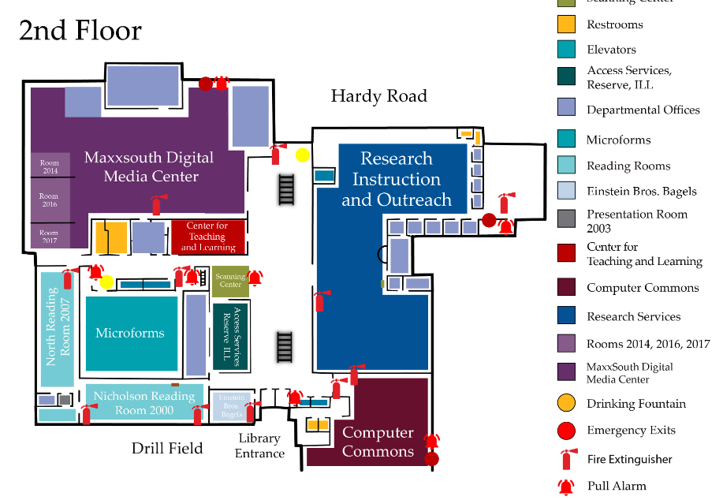
Current 2nd Floor

Slide 26
Proposed 2nd Floor
Social / Study
Collaboration / Wellness
Nutrition / Café-like Atmosphere

Slide 27
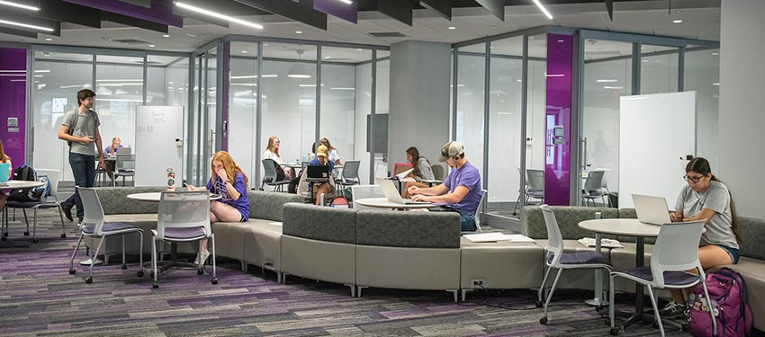
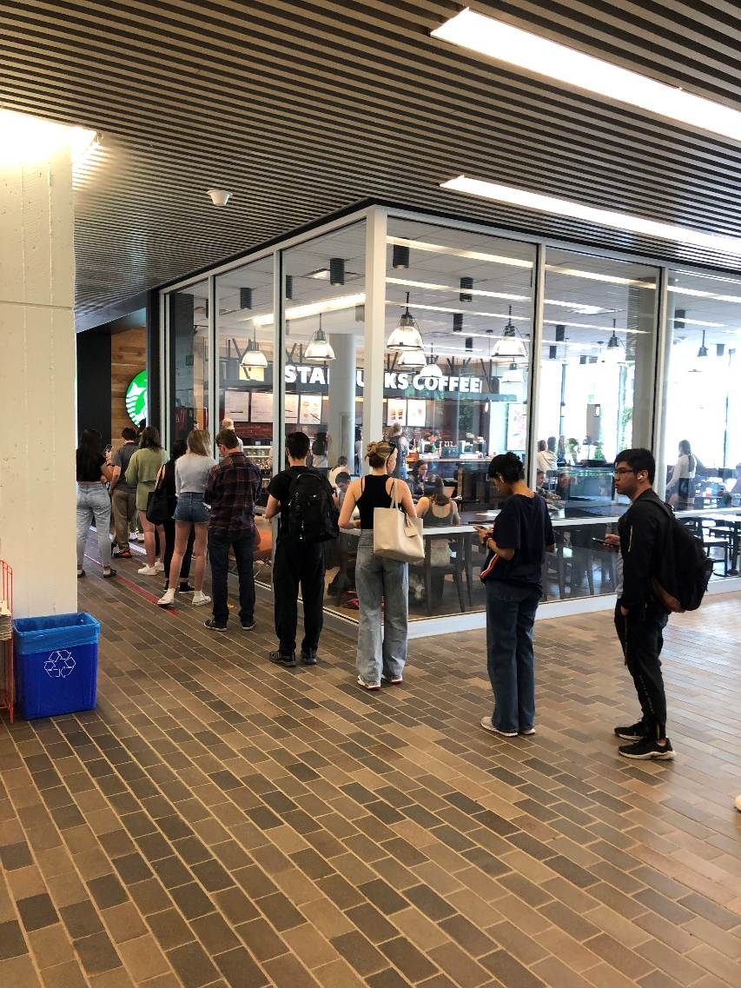
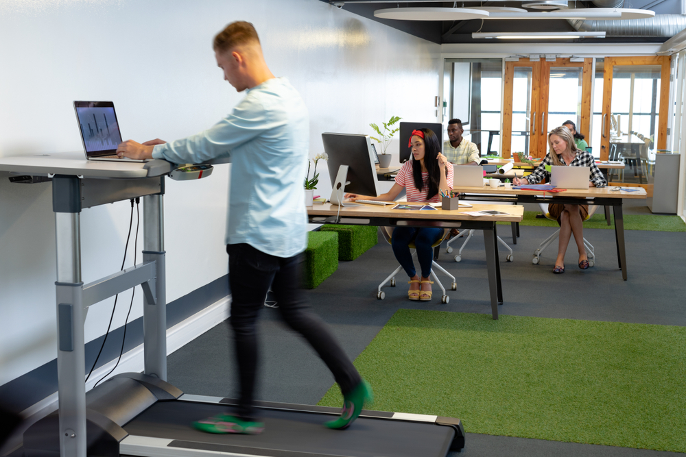
Health & Wellness
Food / Coffee
Collaboration Spaces
Community Building

Slide 28
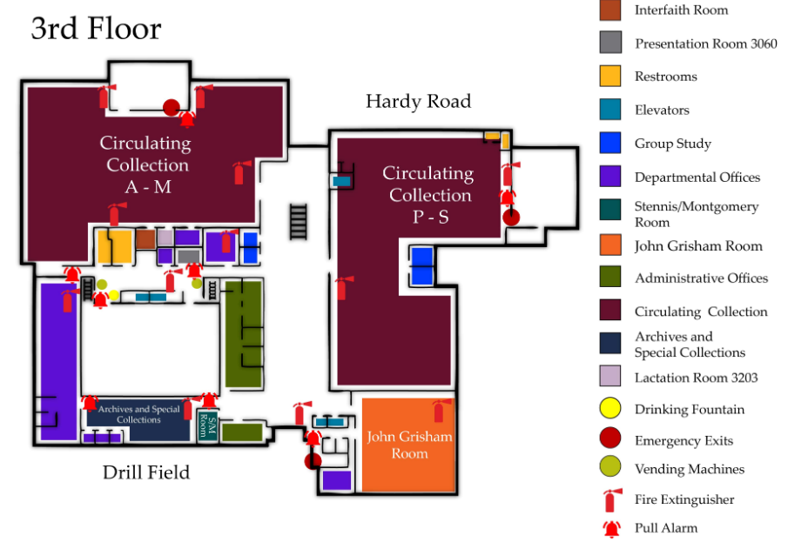
Current 3rd Floor
Circulating Holdings:
A-M: 257,000
P-S: 194,000

Slide 29
STEAM Incubators /
Workspaces
Study Rooms
Student Success
Proposed 3rd Floor
Books moved to 1st floor

Slide 30
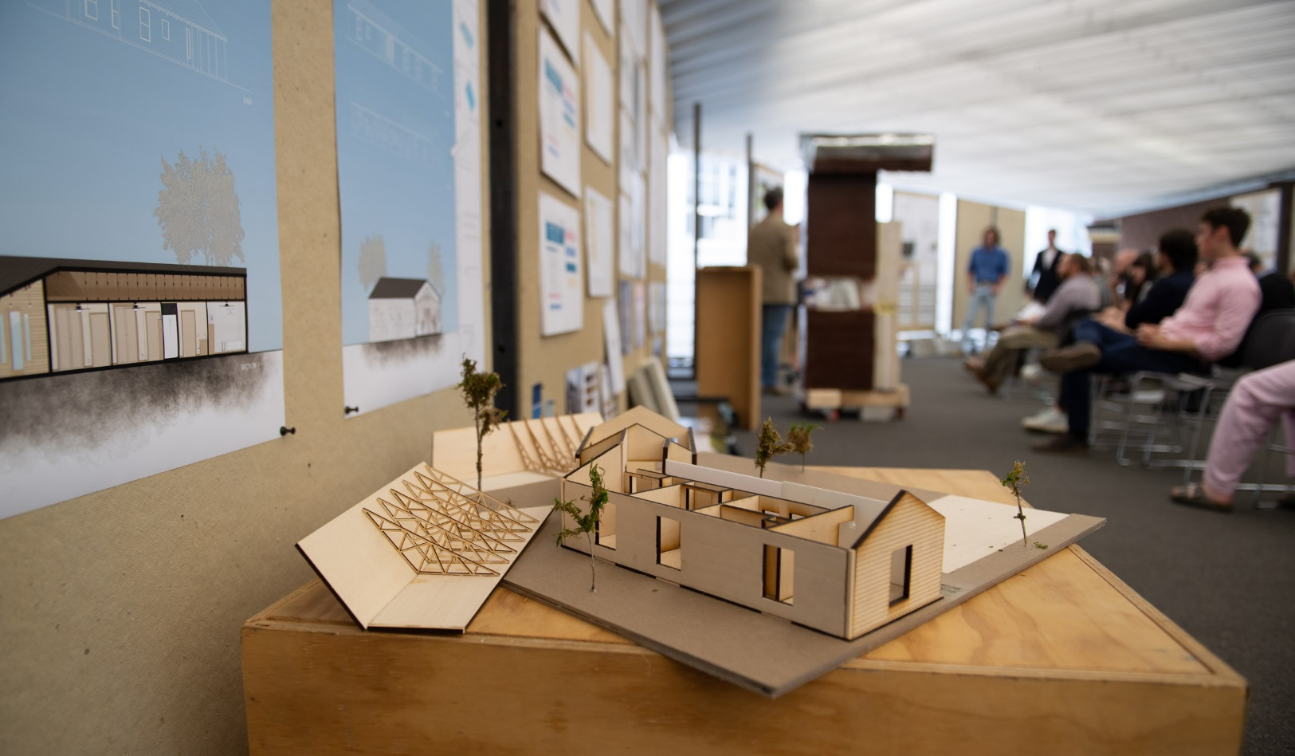
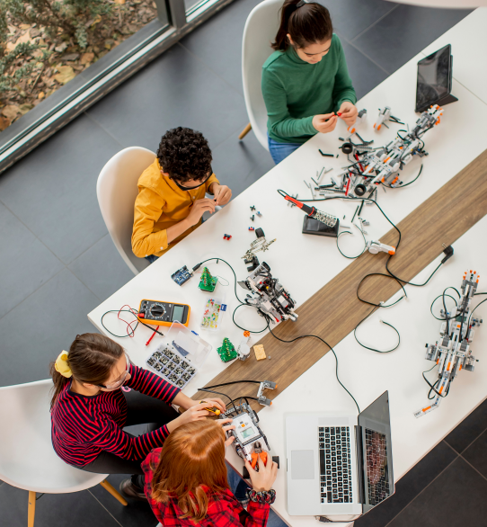
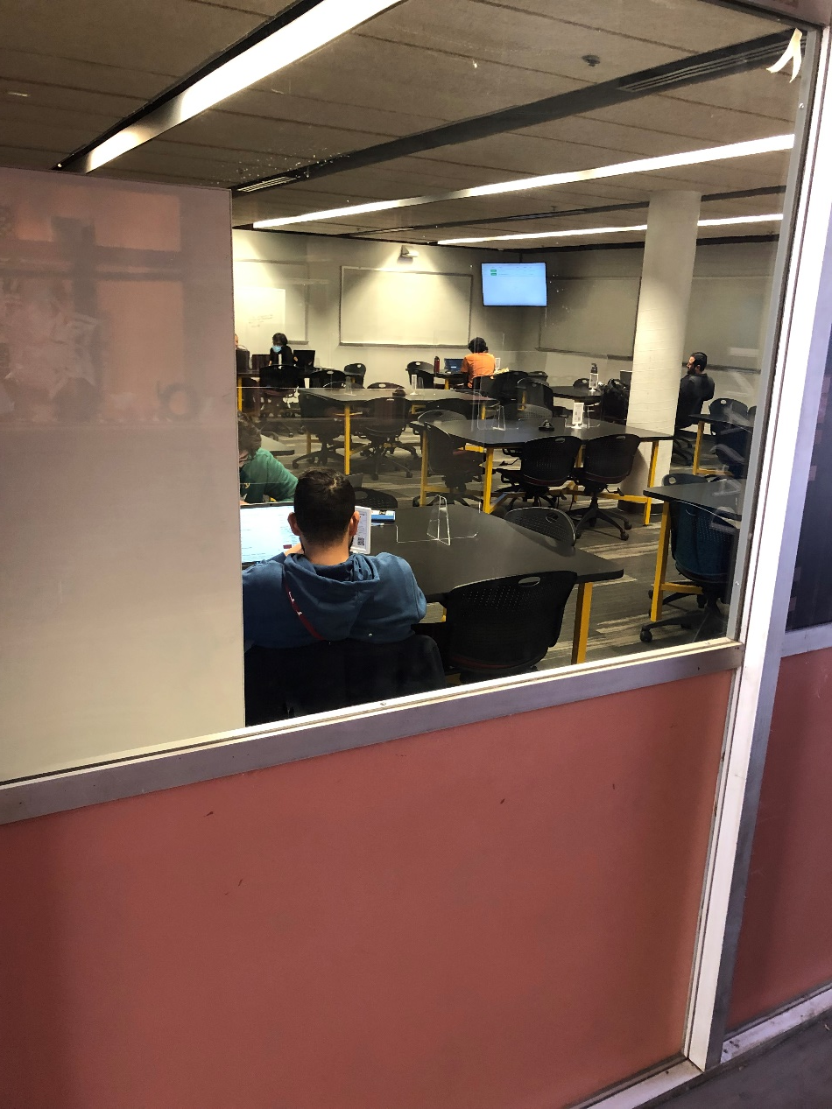
Student Success
Interdisciplinary Spaces
Maker Spaces
Connectivity

Slide 31
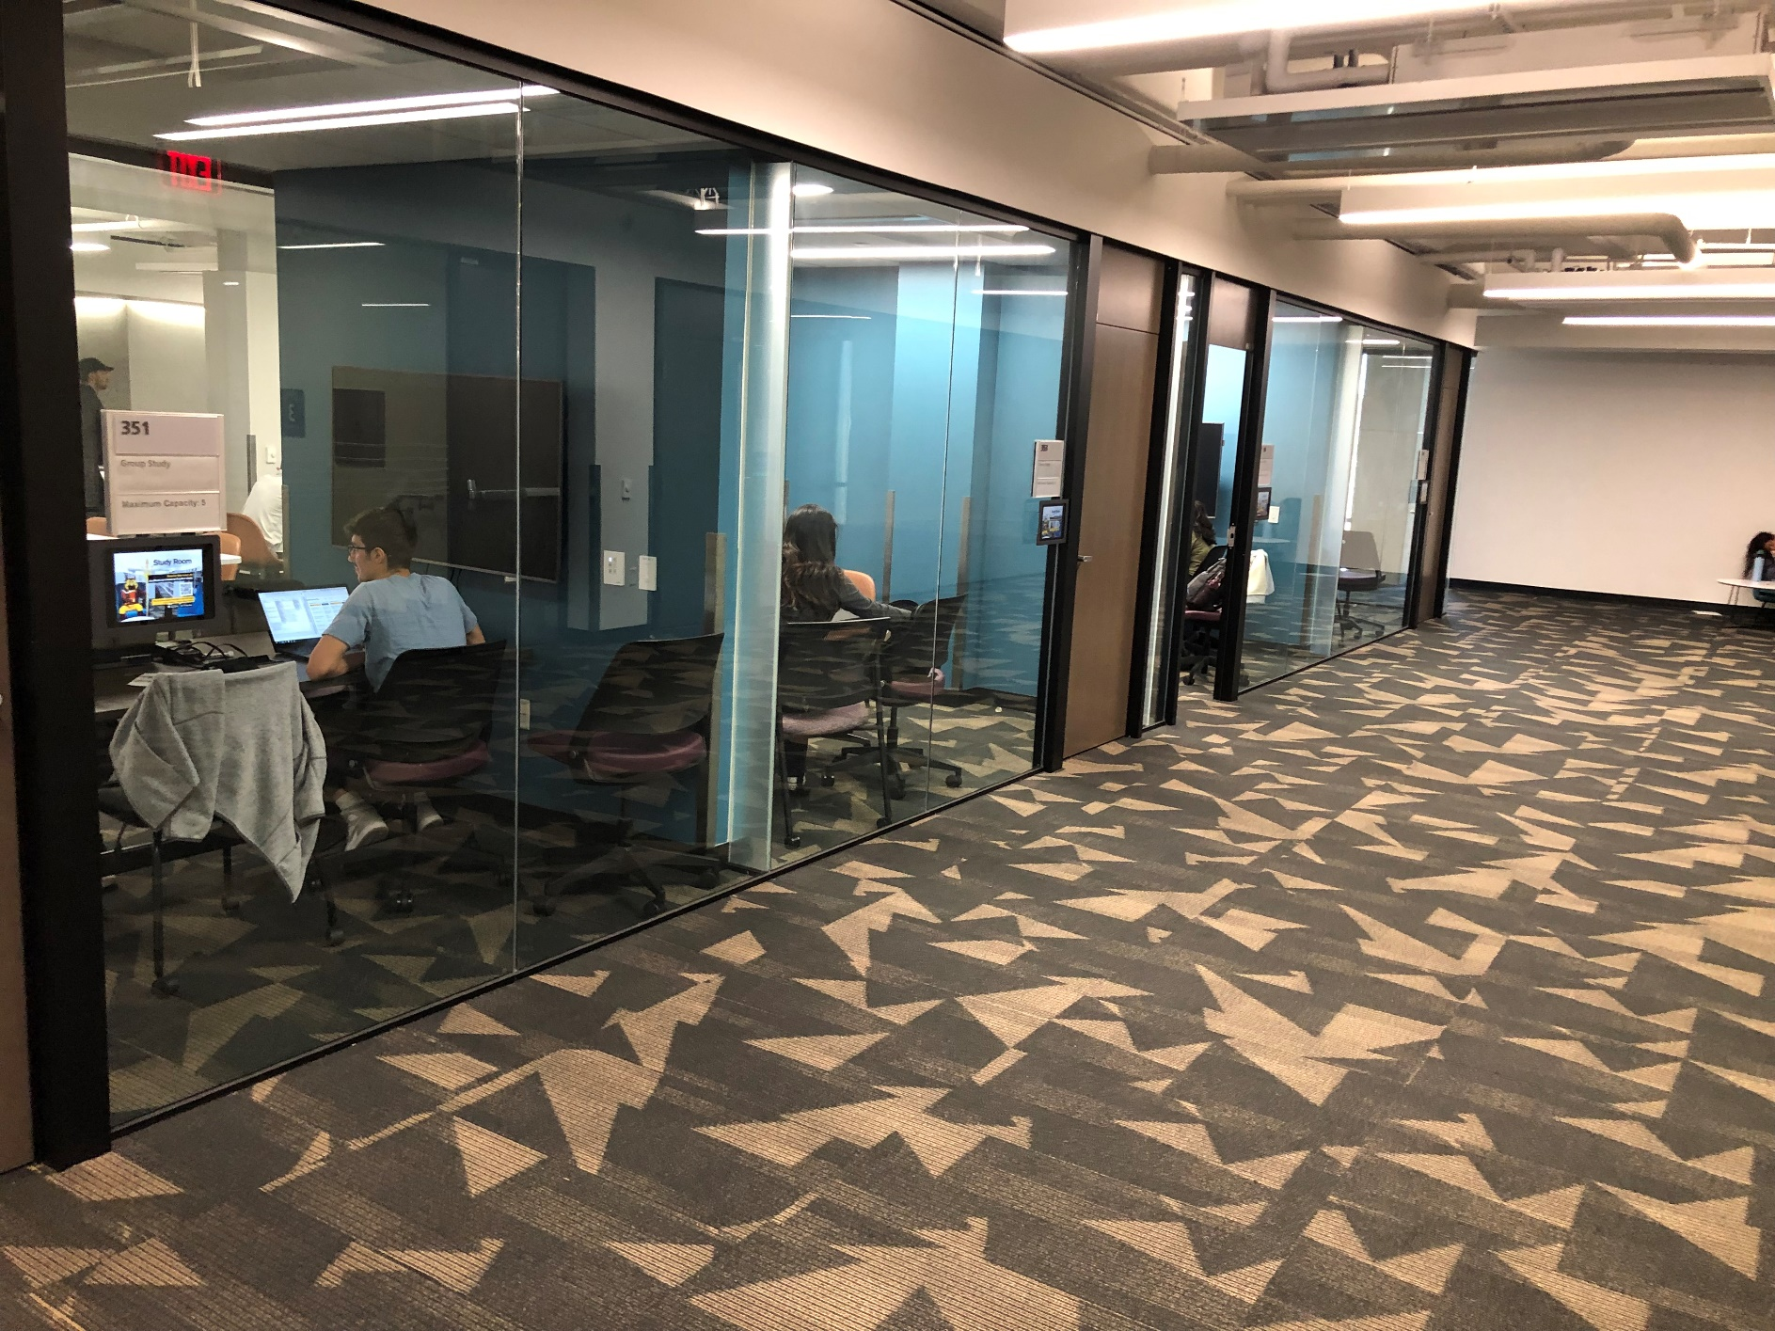
Technology Enhanced Smart Study Rooms
Facilitating supplemental instruction and FYE support

Slide 32
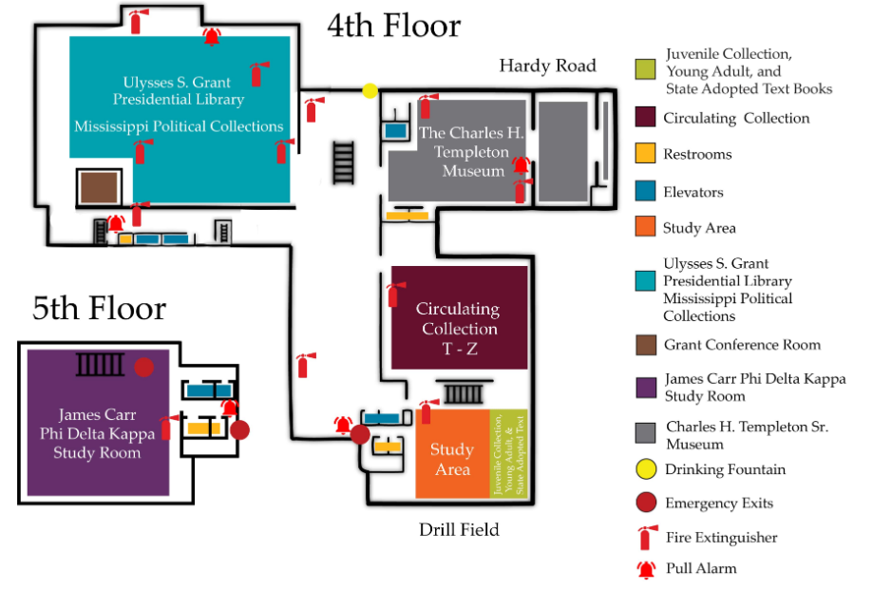
Current 4th & 5th Floors
Circulating Holdings:
T-Z: 42,000

Slide 33
Proposed 4th & 5th Floors
Books moved to 1st floor
Conference Rooms
FYE Space
Study Space
Flex Space

Slide 34
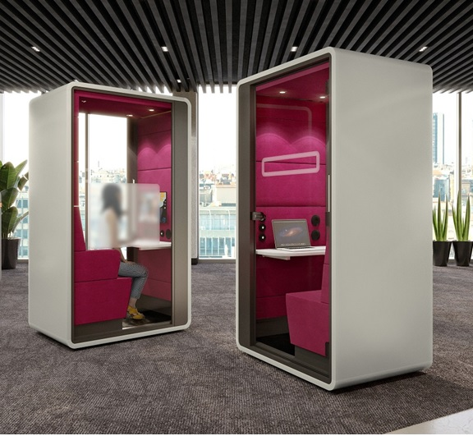

Flex Spaces
Individual Study Pods
Quiet Study
Smartboard/Whiteboards
Conference Rooms
Event Space

Slide 35

Thank You!
Future Directions:
  Donor Engagement
  Interdisciplinarity
  Student Success
  Community Building
Comments and Suggestions

